Slide 1
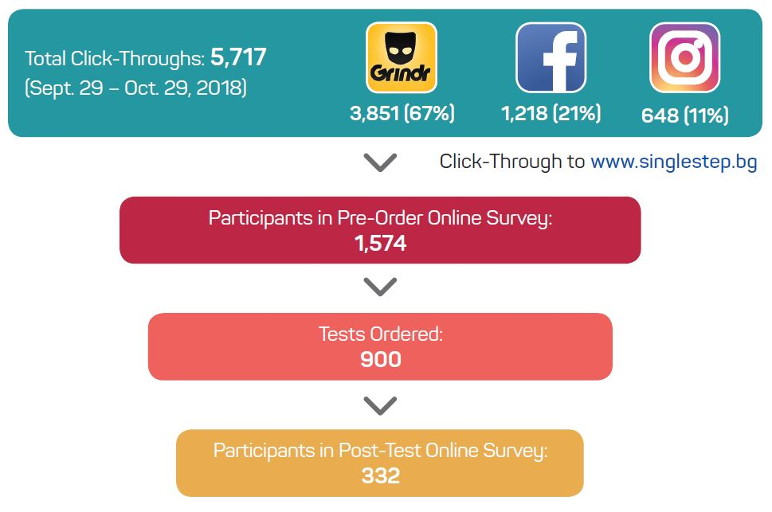
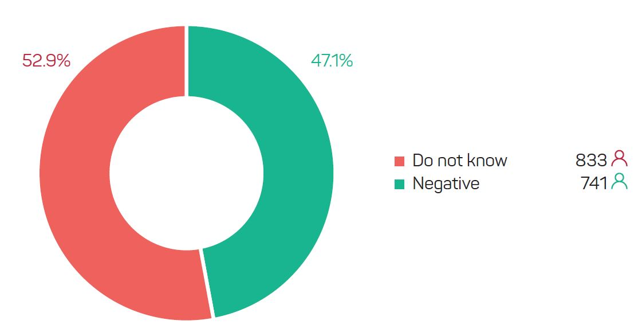
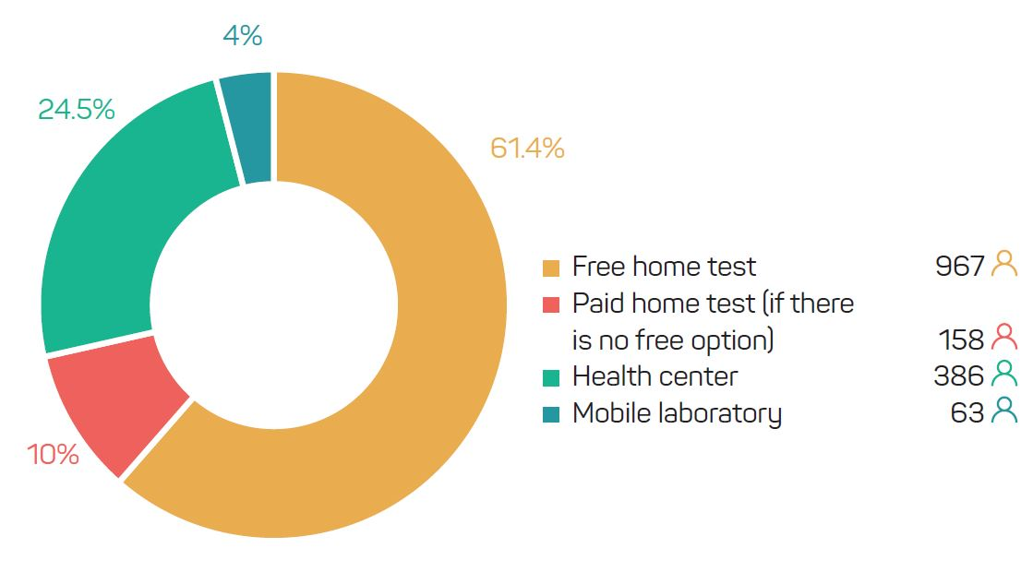
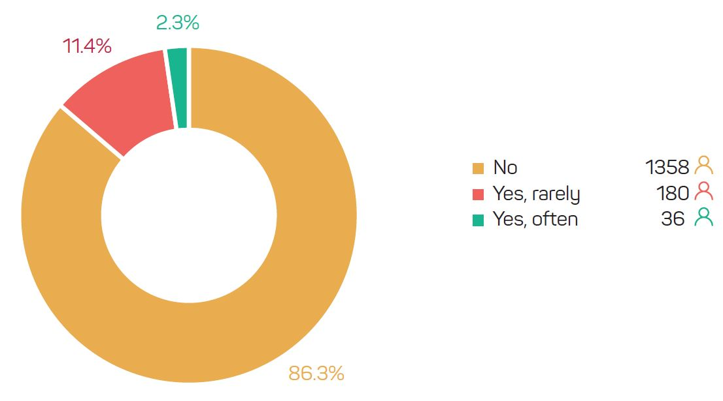
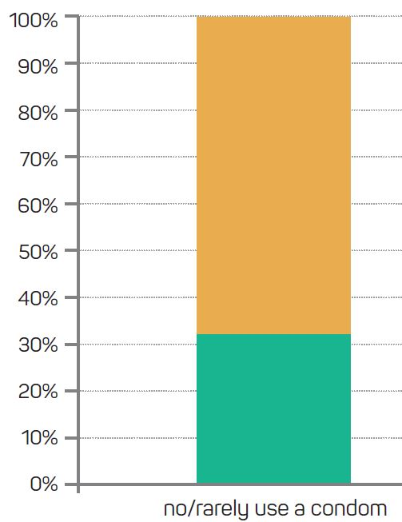
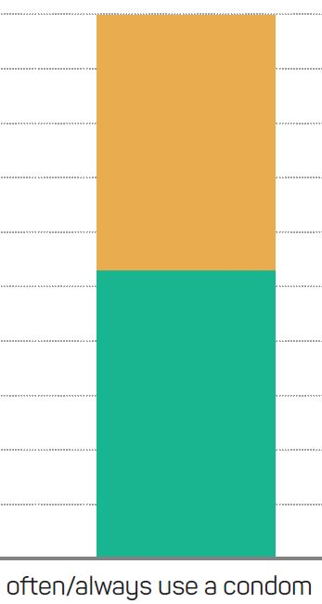
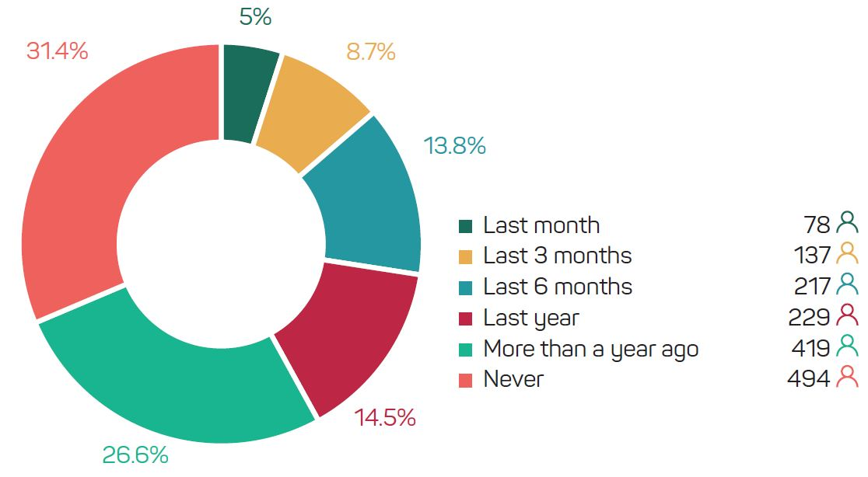
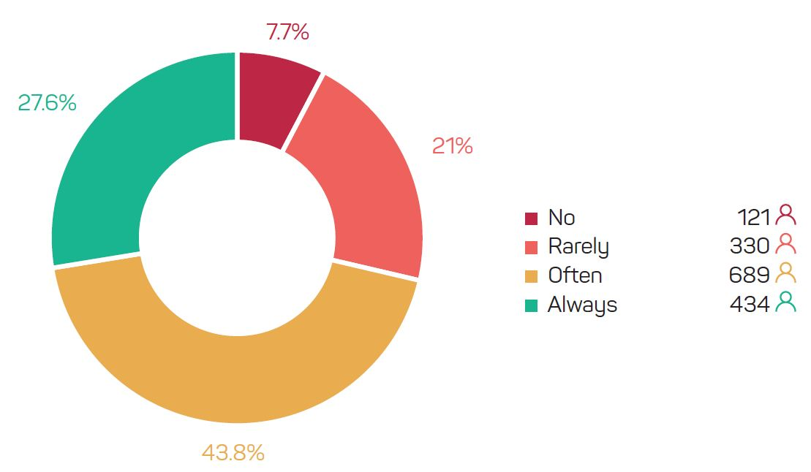
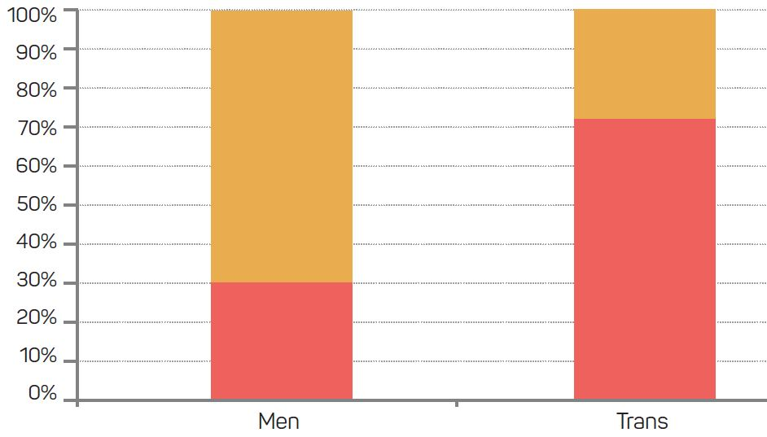
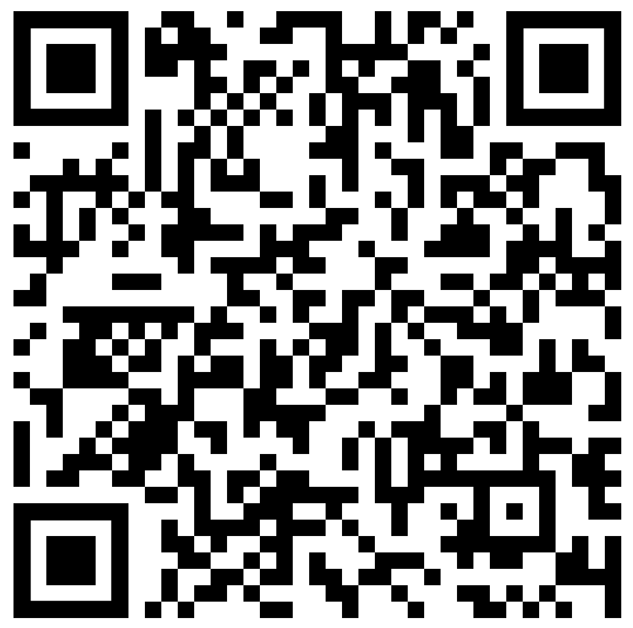
#endHIVbg: an Innovative National Campaign to Engage Hard-to-reach
At-risk MSM and Trans People with a Confidential Rapid Oral Home
HIV test, in partnership with GrindrTM
Momchil Baev, Emilia Naseva, Ivan Dimov, Emmett Patterson
Single Step Foundation, Medical University of Sofia, Grindr for Equality
www.singlestep.bg e-mail: Momchil@singlestep.bg
Background
HIV testing services in Bulgaria are largely institutionalized, presenting a barrier to MSM and trans people who don’t want to be associated with HIV testing due to stigma. The main hypothesis tested is that a large number of the target population don’t use protection and don’t regularly test for HIV. The objective of the research is to show that traditional methods are ineffective for these hard-to-reach communities and that home HIV testing marketed through GrindrTM might be the only viable alternative for the target group in Bulgaria.
Methods
The methodology of the initiative included a combination of distributing 900 free at-home HIV tests, GrindrTM, and targeted online campaigns. The study was held for 2 months in October - November 2018 on a country level in Bulgaria (population of 7.1 mm), covering 1,574 MSM and trans people, age 16 to 62. The study population includes MSM and trans people (2.5%) of Bulgarian origin and 7% of minority background. Data collection was carried out through an online questionnaire. Pearson chi square test was applied (Fisher's exact test when applicable). P-values < 0.05 were considered as significant.
The HIV testing campaign and the accompanying survey hosted on Single Step’s website, were promoted entirely online using advertisement through digital marketing channels (Grindr, Facebook, Instagram). An essential part was the partnership with Grindr, the world’s largest social networking app for MSM, gay, bi, trans and queer people), with its thousands of active monthly users in Bulgaria. Over the course of the campaign, Single Step placed full screen notifications that would appear when users opened the Grindr app, as well as direct inbox messages within the app to all Grindr users in the country. Users were then prompted to order an HIV home test online by clicking on a button which led them to the Single Step website.
Before ordering the home test, users had to first fill out a short eligibility assessment (to verify that they were 16+, had had sex with a man in the prior 12 months, that they were either HIV negative or did not know their status), then continued onto an online survey of 14 questions. After filling out the questionnaire on Single Step’s website, users could place an order for the test free of charge.
A video was produced featuring members of our community and was used on social media platforms to promote the #endHIVbg pilot project.
Results
What is your HIV status?
Which method of HIV testing you prefer?
Do you use drugs?
The HIV status self-declared by the participants before testing with the OraQuick® home kit is negative for half of them (47.1%), while the other half (52.9%) do not know it – either because they did not obtain a previous result or because they have never been tested.
The most preferred HIV testing method is a free home test, indicated by 61.4% of the participants. The second most preferred method is testing at a health center (24.5%), every tenth (10.0%) preferred a paid home test provided that a free home test option is not available, and 4.0% prefer a mobile lab.
More than 4/5 of the respondents (86.3%) declared that they did not use drugs, while slightly more than every tenth (11.4%) reported that they did so rarely and 2.3% did so often.
HIV status and use of condom
When did you last test for HIV?
Do you use a condom when you have sex?
Data shows that those who use a condom more often, more frequently reported that they do not use drugs, have tested for HIV more recently, and have a negative HIV status rather than unknown. Those who frequently or always use a condom, more often reported that they have tested for HIV at some point in their life (73.5%) vs the group who rarely or never use a condom (56.5% have tested for HIV at some point in their lives).
It is interesting to note when the respondents last tested for HIV. Every third (31.4%) has never tested, 26.6% tested more than a year ago, 14.5% – 6-12 months ago, 13.8% – during the last 6 months, 8.7% – in the last 3 months, and only 5.0% – during the last month.
To the question “Do you use a condom when having sex?“, the majority of respondents (43.8%) responded with “often“; only 27.6% said they always do; every fifth (21.0%) rarely uses a condom and 7.7% never use a condom.
Have you ever tested for HIV?
CONCLUSIONS
Screening and testing services outside of Sofia are inaccessible as evidenced by the number of people who have never or rarely tested for HIV, STIs and Hepatitis.
A large proportion of sexually active MSM at risk of HIV do not regularly test. Condoms are not popular among many fractions within the MSM community, thus innovative methods of prevention, such as PrEP.
HIV testing rate is particularly low in the trans and Roma communities.
Men and trans people differ on the basis of a prior HIV test; among men, the portion of those who have never tested is 30.4% and among the other group the percentage is twice as large (71.8%). Men who tested in the last 12 months were 42.6%, while in the other group, only 17.9%. Every fourth man (27%) reported HIV testing more than 12 months ago, while among trans people this is the case for every tenth (10.3%)
HIV self-testing at home is the preferred screening method for MSM in Bulgaria.
Digital channels are an effective route to reach MSM and trans groups.
People newly diagnosed with HIV need mental health services and psychosocial support.
PRESENTED AT THE 10TH IAS CONFERENCE ON HIV SCIENCE (IAS 2019) | MEXICO CITY, MEXICO | 21-24 JULY 2019

